Slide 1
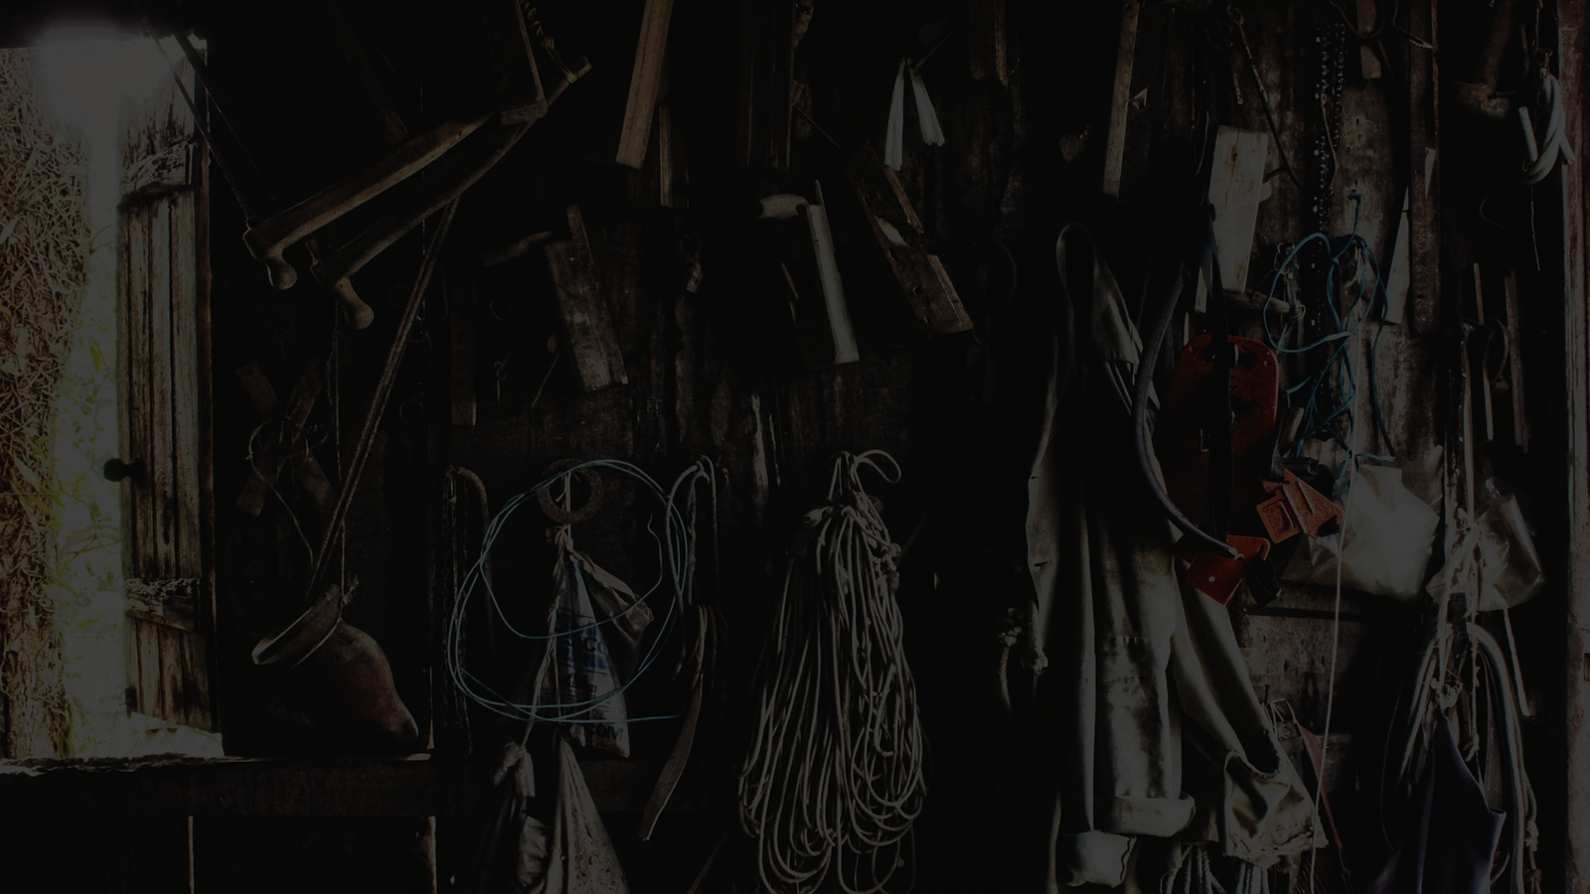
Introduction

Slide 2

Impartial

Slide 3

Collaboration is the key

Slide 4

“Who picks a tool unsuited to a task should not complain if it does no more than cut the hand that holds it.”

